Slide 1
Application Controller Pattern
By: Keith Jacobson

Slide 2
What is an Application Controller?
A centralized point for handling screen navigation and the flow of an application.
How does it differ from a Model View Controller?
MVC can do many of the functions of an application controller, however when the application becomes too complex you can avoid duplicate code and issues by separating the two.
The MVC will contact the application controller for the flow model and get the correct view depending on the context.

Slide 3
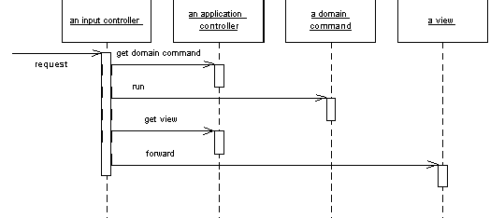
Sequence Diagram of how a Application Controller Works
Source: https://goo.gl/S78zj2

Slide 4
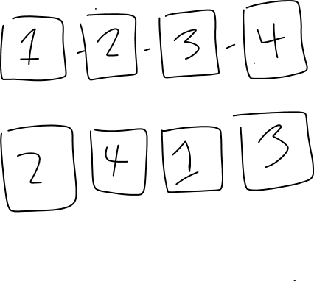

Wrap-up Application Controller
An application controller is a centralized point for handling screen navigation and the flow of an application.
Control UI transition logic in a central place.
Centralize the flow of application and screen navigation, have all the source code in one location. (Easy to make changes.)

Slide 5
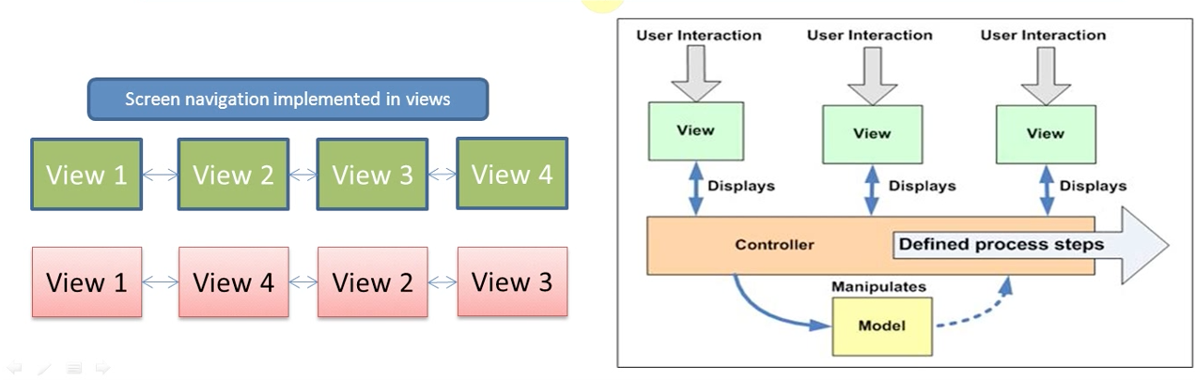
A better example of application controller pattern, then my hand drawn one in slide four…

